Slide 1

Project Team: Lauren Parrish, zehra tokatli, Chase Webb

Slide 2

Background:
Remember going to the movies?
It seems like a bygone activity of yesteryear, but yes people did once go to movie theaters. With the advent of streaming services and, well Covid, most of us have been enjoying films from the comfort of our couch, but there are so many options! How do we know if what we select is “quality” and if something is “quality” is it something that we actually want to watch?
In this project, the team extracted data from an Academy Awards Database and a Streaming Services database to capture information that would enable us to determine:
Do award winning films have higher user ratings?
Do awards impact film popularity on streaming services?
Do award winning directors receive higher ratings?
Do films with winning soundtracks have higher popularity?

Slide 3
Extraction:
Data Sources:
The team leveraged a csv database from Kaggle containing Streaming Service provider information including film names, ratings, and directors.
https://www.kaggle.com/ruchi798/movies-on-netflix-prime-video-hulu-and-disney
The second source was csv database from DataHub containing Oscar nominees and winners. This file would be used as the base for cleaning the replacement file.
https://datahub.io/rufuspollock/oscars-nominees-and-winners
The third source was csv database from Kaggle, also containing Oscar nominees and winners. This file had the film titles required for joining.
https://www.kaggle.com/unanimad/the-Oscar-award
The data sets were downloaded from their corresponding websites and loaded into Jupyter Notebook for Transformation.

Slide 4
Transformation:
Data Cleanse:
Summary of Streaming Data Cleanse:
Drop empty columns
Remove rows that did not contain rating information
Split First and Second Director, drop any additional director information
Split Location cell into Primary and Secondary Location, drop other locations
Split Language into Primary and Secondary Language, drop other languages
Split Genres into eight separate columns
Convert streaming services cells to Booleans
Challenges:
The data contained cells with multiple data points separated by commas. Some cells were not applicable for the team’s analysis and thus the decision was made to drop any additional data elements post the primary and secondary listing. The exception was genre information which was split to populate eight new genre columns.

Slide 5
Transformation:
Data Cleanse:
Summary of Awards Data Cleanse:
Identify unique fields
Combine data with similar music categories
Combine data with similar short film categories
Combine data with similarities for cinematography, art direction
Identify winning actors
Remove “year_ceremony” and “ceremony” columns
Identify winning best pictures
Challenges:
The greatest challenge with the Awards dataset was that there were several columns containing similar categories. This level of detail was not required for the team’s assessment and therefore the data was merged. As we progressed through the initial dataset, we found that it would be difficult to join to the other dataset, so a new source file was used which listed film titles.

Slide 6
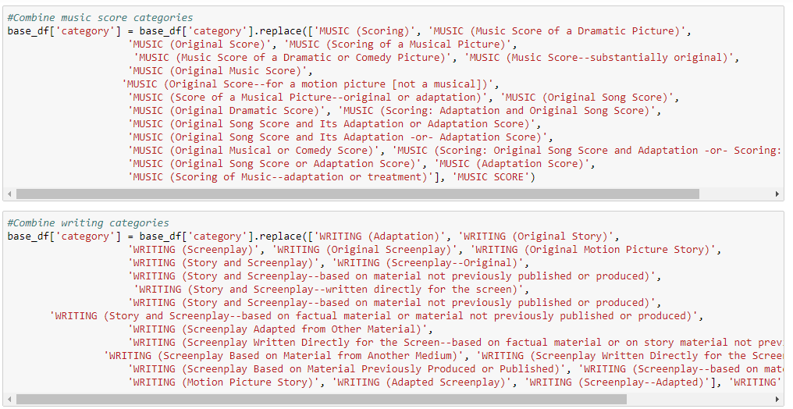
Transformation:
Data Cleanse:
Awards Data Code Example:

Slide 7
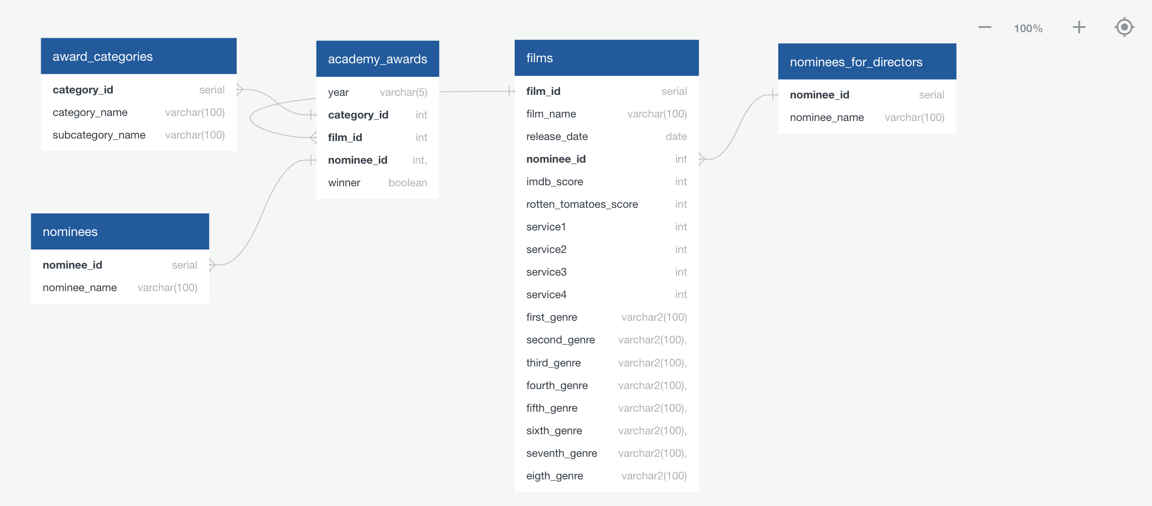
Transformation:
Data Joins:
Join Analysis & ERD:
The introduction of the third data set with film names as a common identifier allowed for the construction of an ERD to assist in the table design for a relational database.
The ERD supported the construction of five tables which were created in PGAdmin. Primary and Foreign keys established for category_id, nominee_id, film_id.
Now it was time to load the data…

Slide 8
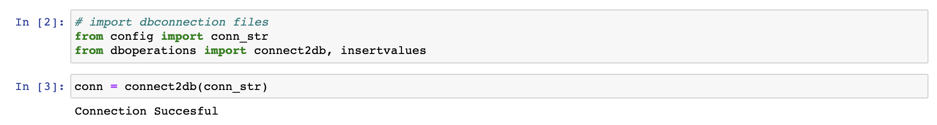
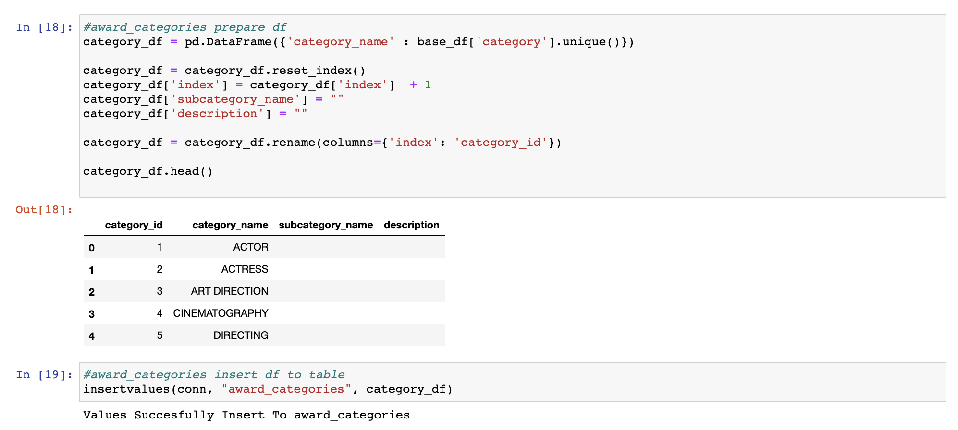
Loading:
Load Code
Functions were added to the original data cleansing code to connect to the database and load the data. Additionally, the data frames were “reframed” to match the database tables.

Slide 9
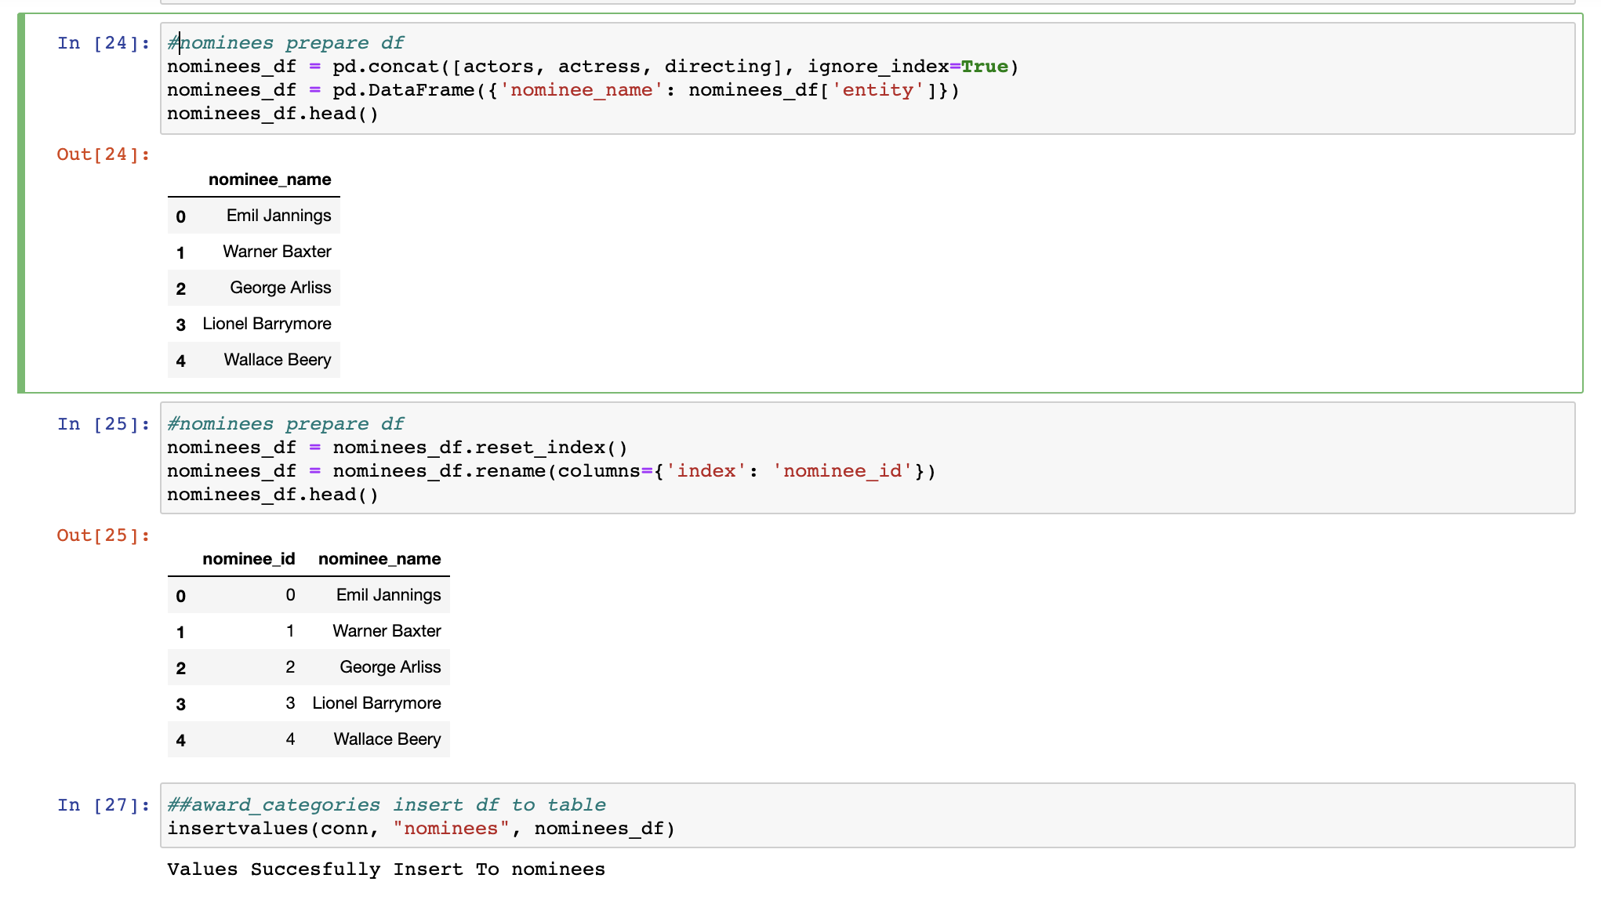
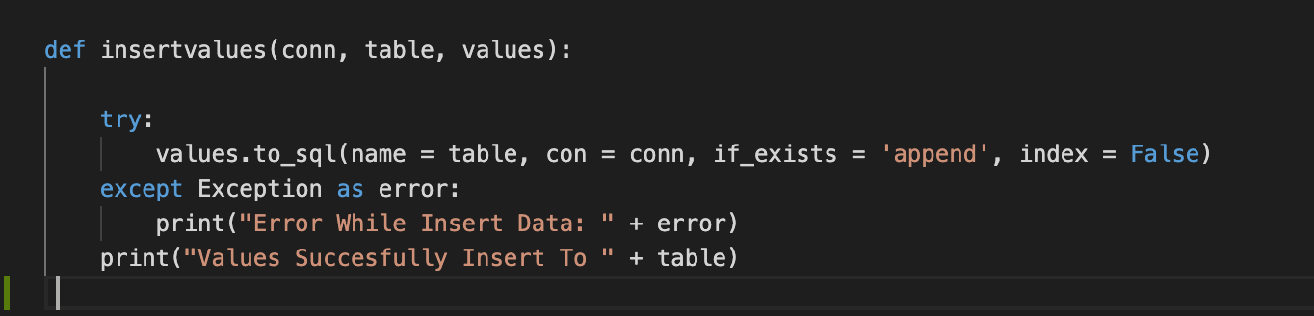
Loading:
Load Code

Slide 10
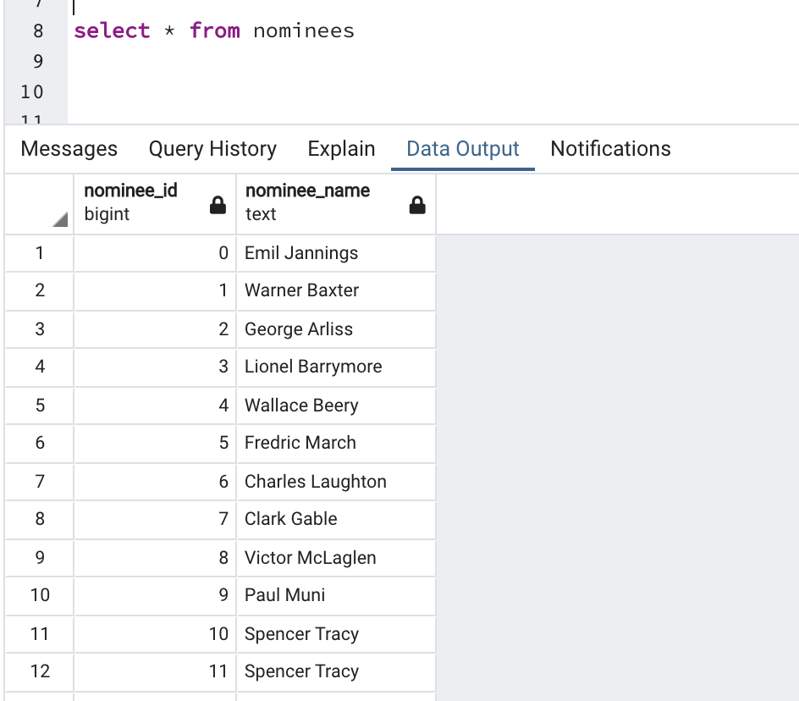
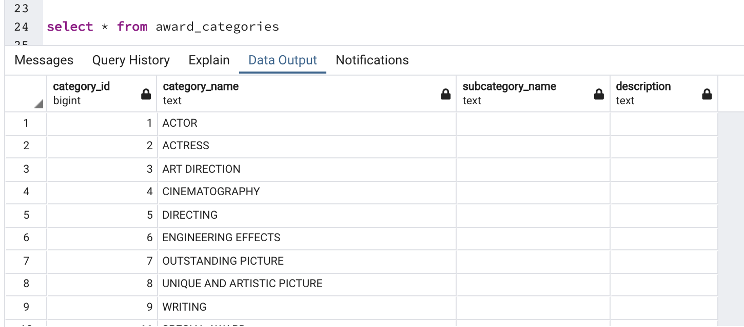
Loading:
Tables
The addition of this code enabled successfully loaded tables.

Slide 11
Lessons Learnt:
Little Discoveries
Data is rarely comes in a Goldilocks form even when it looks clean to start. It can have too much information, too little, or just be nuanced enough to cause problems.
Common data fields are critical when constructing relational databases. Strings can be used, but unique numeric identifiers are preferred.
The detail required in the Pandas coding library to export data frames to the database tables can cause numerous errors and delays. The team witnessed numerous issues with indexing and primary/foreign keys.
Don’t create code errors that duplicate your original data set from 5,000 rows to 15,000. You’ll loose an hour just trying to run it.

Slide 12
Questions???

